Slide 1
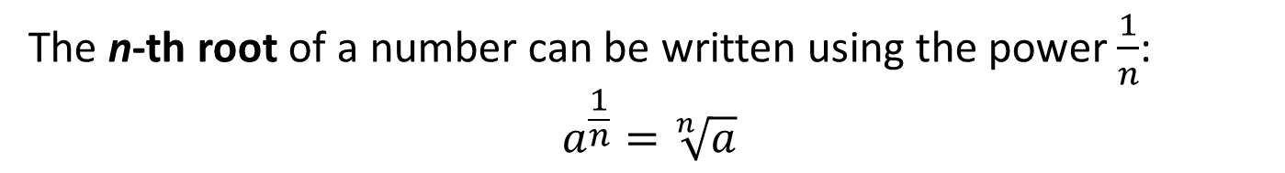
24
7
30
Title: Fractional Indices
EQ : How do I express a fractional index as a surd?
Question:
Notes:
Fractional indices (exponents) can be used instead of using the surds sign (√).
We use fractional exponents because often they are more convenient, and it can make algebraic operations easier to follow.
The n-th root of a number can be written using the power $\frac{1}{n}$:
$$a^{\frac{1}{n}}=\sqrt[n]{a}$$
17

Slide 2
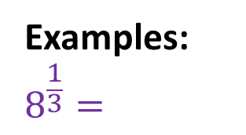
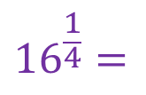


24
7
30
Title: Fractional Indices
EQ : How do I express a fractional index as a surd?
Examples:
$$8^{\frac{1}{3}}=$$
$$\sqrt[3]{8 }=$$
2
$${16}^{\frac{1}{4}}=$$
$\sqrt[4]{16 }=$
2
17

Slide 3
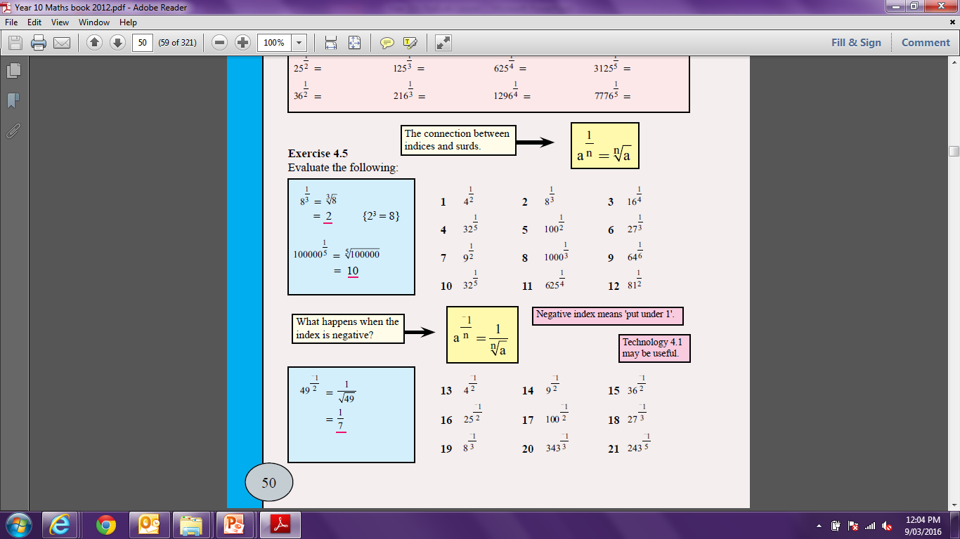

Slide 4
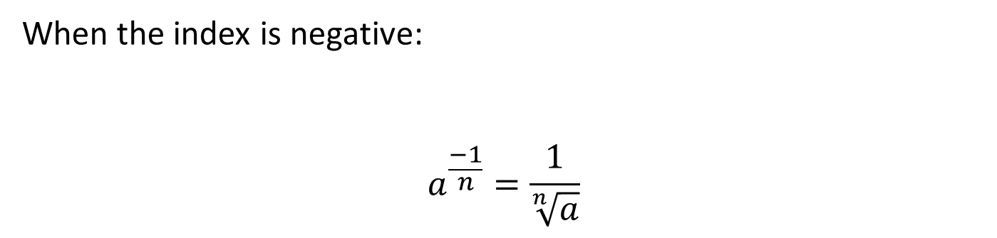
24
7
30
Title: Fractional Indices
EQ : How do I express a fractional index as a surd?
Question:
When the index is negative:
$$a^{\frac{−1}{n}}=\frac{1}{\sqrt[n]{a}}$$
17

Slide 5


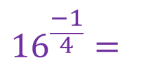


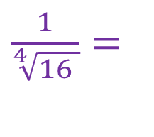
24
7
30
Title: Fractional Indices
EQ : How do I express a fractional index as a surd?
Examples:
$$8^{\frac{−1}{3}}=$$
$$\frac{1}{\sqrt[3]{8 }}=$$
$$\frac{1}{2}$$
$${16}^{\frac{−1}{4}}=$$
$\frac{1}{\sqrt[4]{16 }}=$
$$\frac{1}{2}$$
17

Slide 7
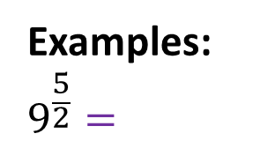



24
7
30
Title: Fractional Indices
EQ : How do I express a fractional index as a surd?
Examples:
$$9^{\frac{5}{2}}=$$
$$(\sqrt[2]{9})^{5}$$
$$= 3^{5}$$
$$=243$$
17

Slide 8
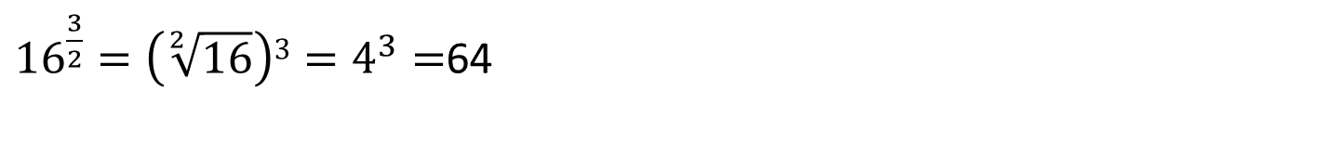
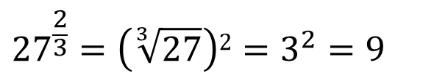
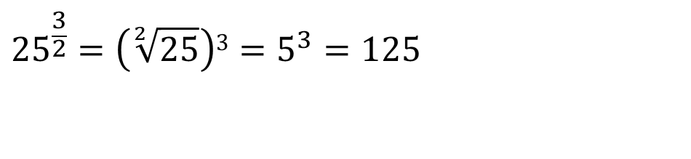
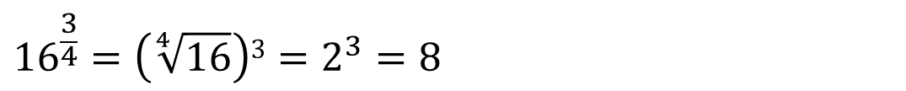
Questions
$${27}^{\frac{2}{3}}=\left(\sqrt[3]{27}\right)2=3^{2}=9$$
${16}^{\frac{3}{2}}=\left(\sqrt[2]{16}\right)3=4^{3}=$64
$${16}^{\frac{3}{4}}=\left(\sqrt[4]{16}\right)3=2^{3}=8$$
$${25}^{\frac{3}{2}}=\left(\sqrt[2]{25}\right)3=5^{3}=125$$

Slide 9
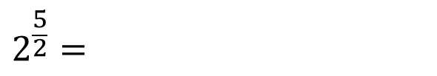
Questions
$$2^{\frac{5}{2}}=$$
$$3^{\frac{3}{2}}=$$
$$5^{\frac{3}{2}}=$$

Slide 10
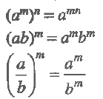

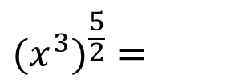



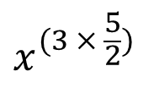

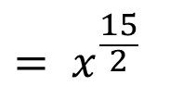

Title: Fractional Indices and Index Laws
EQ : How do I apply the index laws to fractional indices?
Index Law:
$$(x^{3})^{\frac{5}{2}}=$$
$$x^{(3 × \frac{5}{2})}$$
$$= x^{\frac{15}{2}}$$
$$(\frac{4}{9})^{\frac{3}{2}}=$$
$$\frac{(\sqrt[2]{4})^{3}}{(\sqrt[2]{9})^{3}}=$$
$$\frac{8}{27}$$
$$(\frac{4}{9})^{\frac{−3}{2}}=$$
$$\frac{(\sqrt[2]{9})^{3}}{(\sqrt[2]{4})^{3}}=$$
$$\frac{27}{8}$$
17

Slide 11
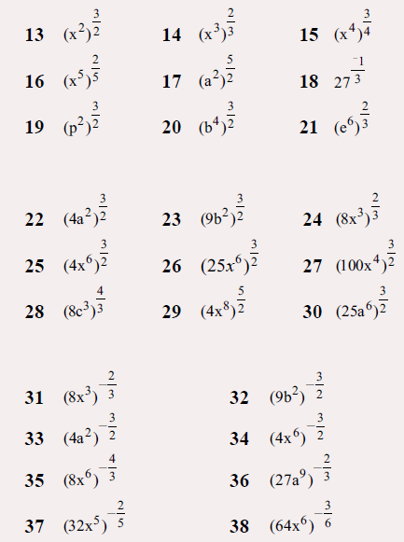
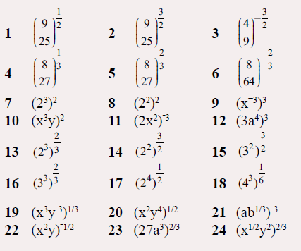

Slide 12
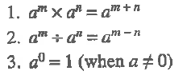
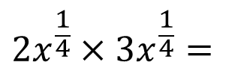
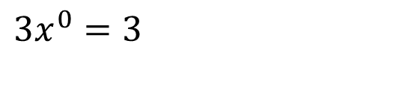
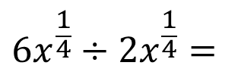
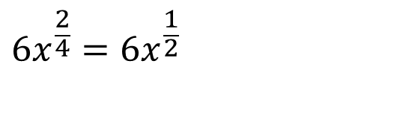
Title: Fractional Indices and Index Laws
EQ : How do I apply the index laws to fractional index?
Index Law:
$$2x^{\frac{1}{4}}×3x^{\frac{1}{4}}=$$
$$6x^{\frac{2}{4}}=6x^{\frac{1}{2}}$$
$$6x^{\frac{1}{4}}÷2x^{\frac{1}{4}}=$$
$$3x^{0}=3$$
17

Slide 13
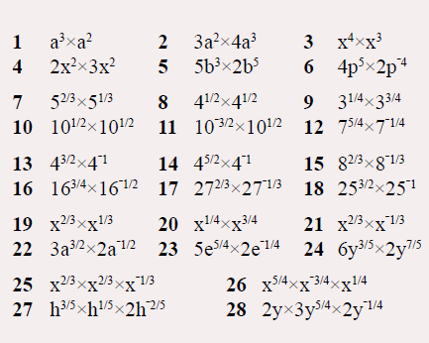
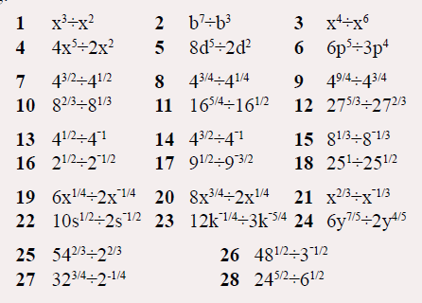

Slide 14
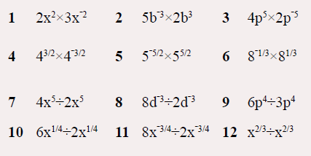

Slide 15
Homework
Review your notes and write a summary answering the essential question.

